Slide 1
Cantilever Beams
Theory of Natural Frequency
Presented By:
Anveesha Arora

Slide 2
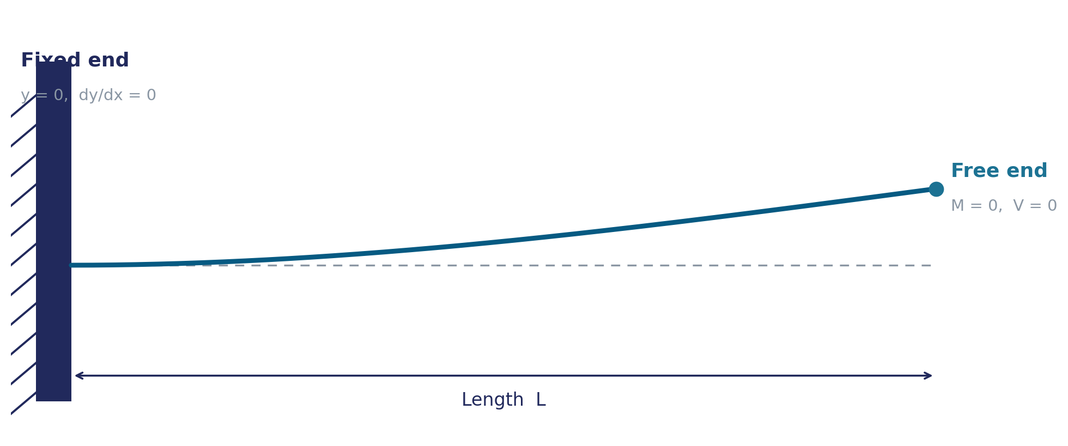
What is a cantilever?
A beam fixed rigidly at one end, free at the other
Fixed end
Free end
Everyday examples
No movement
No rotation
bolted, welded, or built-in
No external moment — nothing restrains it
Diving boards
tree branches
aircraft wings
2

Slide 3
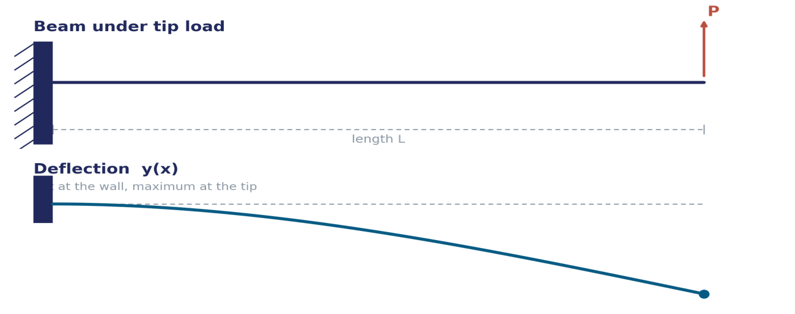
Typical behavior under a static load
Maximum deflection occurs at the free end.
Maximum bending moment occurs at the fixed end.
The stored elastic energy causes vibration when the load is removed.
3

Slide 4
Why does a cantilever vibrate?
Stiffness
Everyday check
1
The beam elastically resists bending and always tries to snap back straight. This is the restoring force.
A short ruler hanging off a desk edge vibrates fast and buzzy.
A long ruler off the same desk vibrates slow and lazy.
Same material, same stiffness — length alone changes everything.
Inertia (mass)
2
The material has weight, so it resists changing direction instantly — this is what makes it overshoot.
4

Slide 5
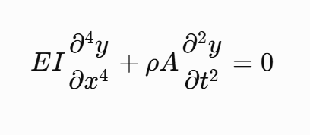
Governing equation & boundary conditions
Euler–Bernoulli beam equation
Four boundary conditions pin down the vibration shape:
Fixed end · x = 0
Fixed end · x = 0
Free end · x = L
Free end · x = L
Deflection = 0
Slope = 0
Bending Moment = 0
Shear = 0
The wall doesn't move
The beam can't tilt at the wall
Nothing forces it to curve there
Nothing pushes on the tip
Frequency equation
Frequency equation
cos(βL) · cosh(βL) = −1
5

Slide 6
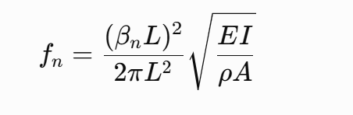
Roots of the frequency equation
βₙL roots:
Natural frequency formula
Mode | βₙL | Nodes
1st (fundamental) | 1.875 | 0
2nd | 4.694 | 1
3rd | 7.855 | 2
4th | 10.996 | 3
EI — stiffness of the beam (material × cross-section shape)
ρA — mass per unit length (density × area)
L — beam length
βₙL — shape factor from the mode, taken from the table
For n ≥ 4:
βₙL ≈ (n − 0.5)π
Roots space out almost evenly by π as mode number grows.
6

Slide 7
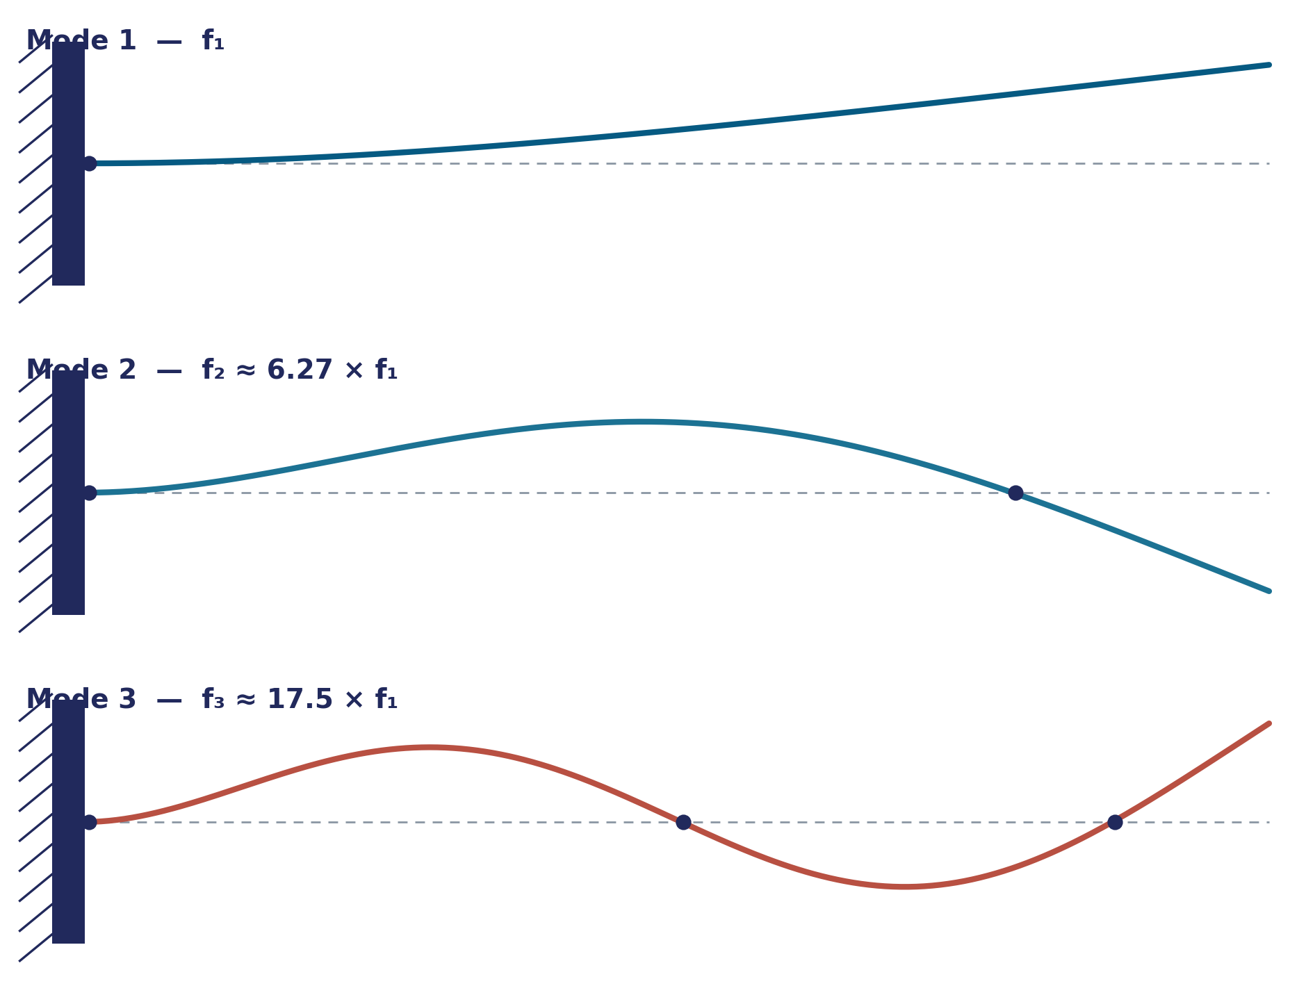
The first three mode shapes
Each mode is a natural frequency paired with its own vibration shape
Mode 1
Whole beam sways as one smooth arc — dominates real-world vibration
Mode 2
One stationary node, ~78% along the length
Mode 3
Two stationary nodes, more curvature per unit length
7

Slide 8
What natural frequency depends on
— every factor below lives inside this formula
Factor | Symbol | Effect on frequency
Length | L | ↑ length → ↓↓ frequency (strongest effect, 1/L²)
Stiffness | E | ↑ stiffness → ↑ frequency
Cross-section shape | I | ↑ shape resistance → ↑ frequency
Density | ρ | ↑ density → ↓ frequency
Cross-section area | A | ↑ area (more mass) → ↓ frequency
Mode number | n | higher mode → ↑ frequency
Boundary conditions | — | changes βₙL entirely
Tip mass | M | ↑ tip mass → ↓ frequency
8

Slide 9
Why silicon is the material of choice
Most real-world cantilevers used for sensing are micro-fabricated from silicon
Where silicon cantilevers are used
Near-perfect elasticity – returns to its original shape with minimal energy loss.
High quality factor (Q) – low damping gives sharp resonance peaks for accurate PSD analysis.
High strength-to-density ratio – lightweight and stiff, leading to high resonant frequencies.
AFM probes
Atomic force microscopy tips — nanometer-scale topography and force imaging
MEMS resonators
On-chip timing references and oscillators, replacing quartz crystals
Mass / gas / biosensors
A tiny added mass shifts the resonant frequency — used to detect single molecules, gases, or pathogens
9

Slide 10
Thank You

